Slide 1


Entrepreneurship and business modelling
1st assignment
Identity, mission and vision
Adrián Barba Beltrán
Rodrigo Martín Gómez del Moral Herranz
Álvaro Honrubia Genilloud
César Pantoja Rosales
Javier Rodríguez García
Jose Antonio Ruiz Heredia

Slide 2
Mission
The retail industry rely on outdated and fragmented systems.
Individual stores don’t integrate essential tools:
Inventory management
Customer databases
Online payments
Traditional solutions require frequent updates, and specialized technical support, making them costly and difficult to maintain.
Empowering businesses with a modern and accessible POS solution that integrates:
Payments
Data analytics
Customer loyalty
Making business management simple and efficient.
POS - Point of Sale: Systems businesses use to complete sales transactions.
Includes hardware (cash register, card reader, tablet, …) and software that processes payments, tracks inventory, and manages customer data.

Slide 3
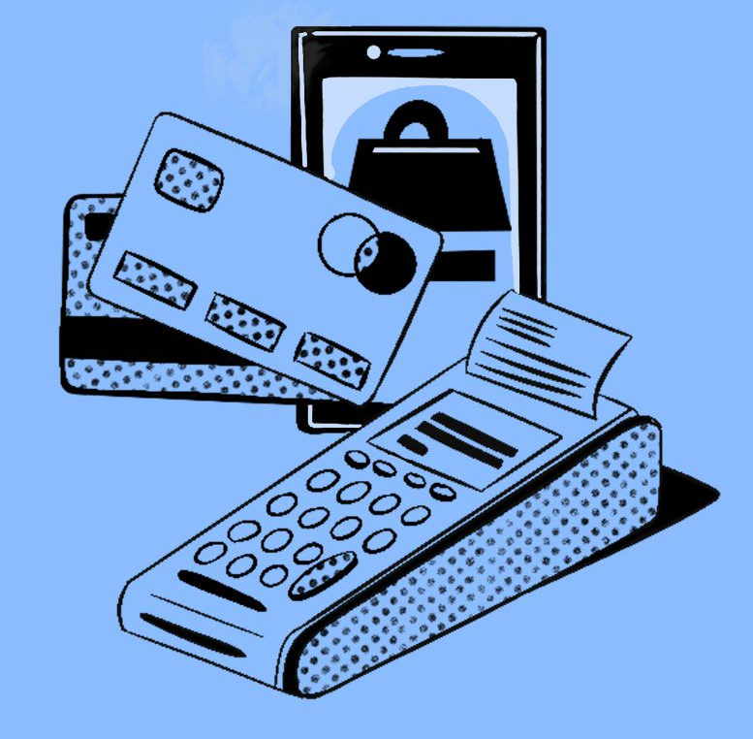
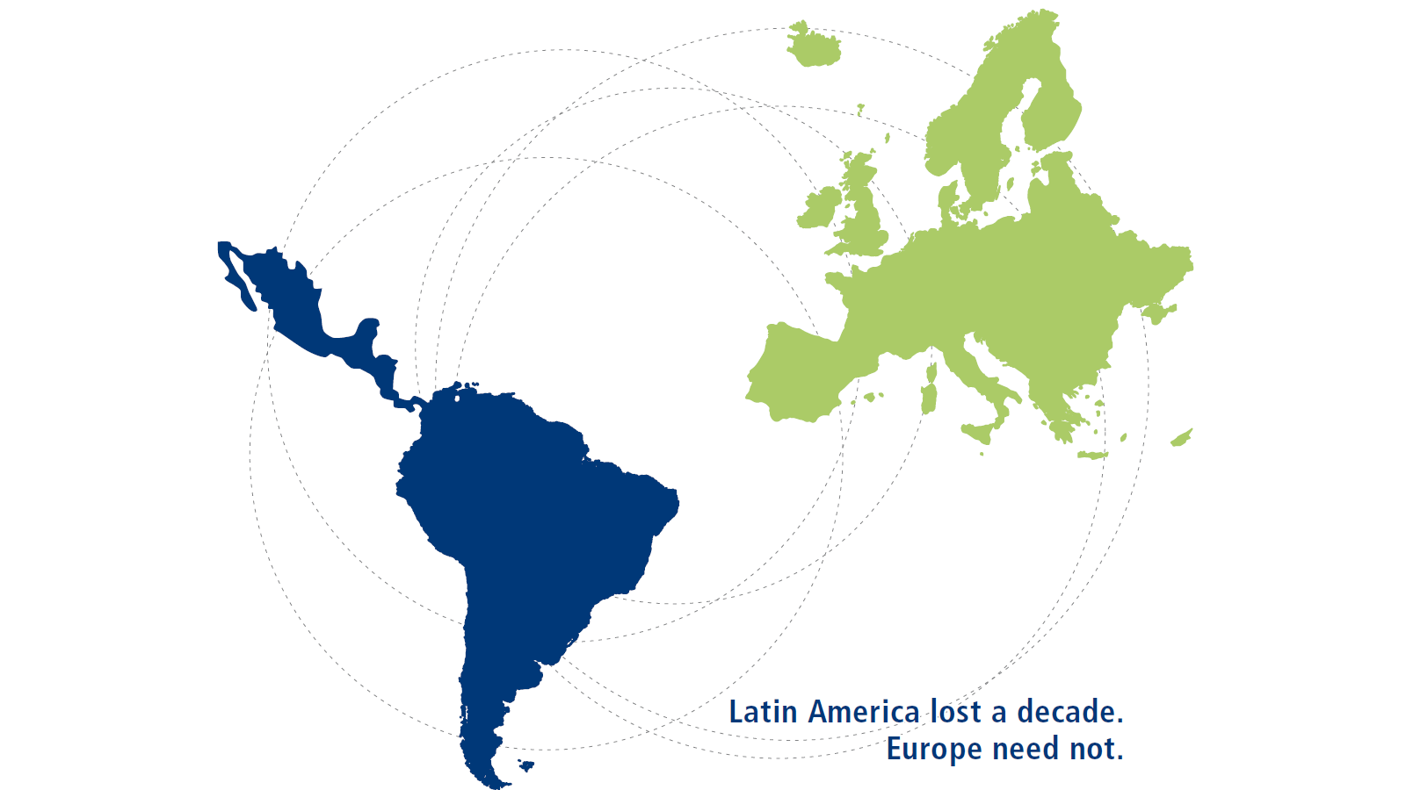
Vision
Values
Become the leading smart POS platform in Latin America and Europe.
Revolutionize the way businesses manage sales and customer relationships.
Innovation – Transforming commerce with cutting-edge technology.
Simplicity – Intuitive and user-friendly solutions.
Accessibility – Making modern technology available to all businesses.
Security – Ensuring safe and reliable transactions.
Growth – Helping small and medium-sized businesses thrive.

